Slide 1


Currency Converter Using
Python
Submitted by:
Aman Kumar Thakur - AP23110011682
Sameer Bachhar - AP23110011496
Bibek Kumar Sah- AP23110011548
Bikash Kumar Mahato- AP23110011681
www.reallygreatsite.com
1

Slide 2

Problem Statement
In today’s globalized world, currency conversion is essential for a variety of users from international travelers and online shoppers to multinational businesses and stock traders. Despite the availability of online tools, many lack the convenience, speed, and simplicity needed for regular use.
Challenges with Existing Tools:
Mostly web-based — not reliable offline
Filled with ads and complex UI
Mobile-focused apps that lack desktop alternatives
2

Slide 3
Our Goal:
Create a simple, offline-capable desktop application
Provide real-time currency conversion using API
Build a minimal, fast, and user-friendly GUI
Objectives:
Design a Graphical User Interface (GUI) using Python’s Tkinter library.
Use the ExchangeRate-API to fetch live exchange rates.
Allow users to select any currency combination and enter the amount.
Handle invalid input and connection issues gracefully.
Implement multithreading to ensure the UI remains responsive during API calls.
Deliver a desktop-friendly experience with simple interactions.
3

Slide 4

Technology Stack
Component
Technology Used
Language
GUI Library
API
HTTP Requests
OS Compatibility
Python 3
Tkinter
ExchangeRate-API
requests library
Windows / Linux / macOS
Python
JavaScript
Java
C++
Ruby
4

Slide 5
System Architecture
User Input
↓
Tkinter GUI (Currency Selection + Amount Entry)
↓
Send API Request (ExchangeRate-API)
↓
Receive JSON Response
↓
Extract Rate & Calculate Converted Amount
↓
Display in GUI
5

Slide 6
UI/UX Design Features
Clean, modern dark-themed interface.
Intuitive dropdown menus for selecting currencies.
Input field with numeric validation.
Convert button with instant action feedback.
Final result displayed in large, styled text.
Focused on simplicity and performance.
6

Slide 7
Application Workflow
User launches the app.
Select “From” and “To” currencies via dropdown.
Enter the amount to convert.
Press the Convert button.
API fetches real time exchange rate.
Result displayed clearly on screen.
7

Slide 8
Code Explanation
requests.get() used to retrieve live exchange data.
API returns JSON; code extracts conversion_rate.
Tkinter widgets:
Entry for input.
OptionMenu for currency selection.
Label to display result.
threading.Thread() used to perform API calls without freezing the GUI.
8

Slide 9
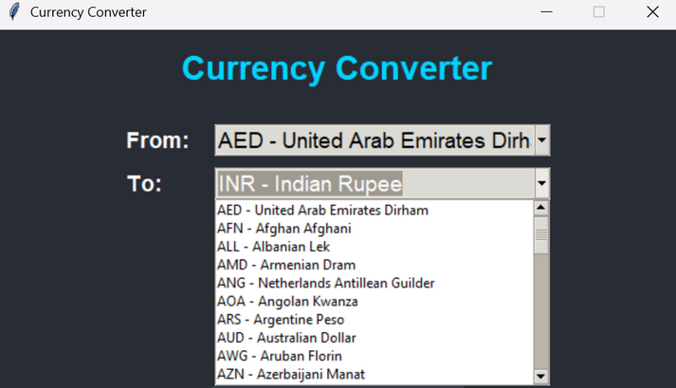
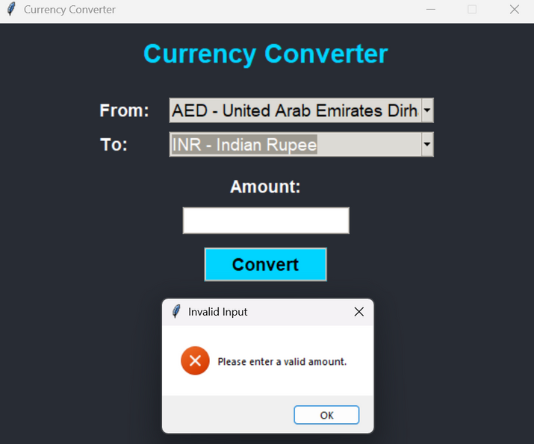
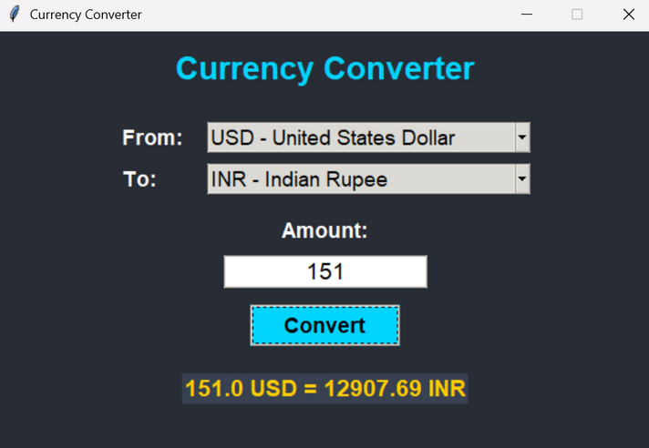
Screenshots
Currency Dropdown Menus
⚠️Error Message (invalid input)
9
Converted Output Display

Slide 10
Conclusion
We developed a Currency Converter desktop application using Python and Tkinter, featuring a clean and user-friendly interface.
The app integrates a real-time exchange rate API to ensure accurate currency conversions. To enhance performance, multithreading was used to keep the UI responsive during data fetching.
As a team, we effectively divided tasks such as UI design, API integration, and testing.
Through this project, we gained hands-on experience in API handling, GUI development, and collaborative software engineering.
10

Slide 11
Thank You
11

